Slide 1
Planet
hi-Fi Prototype
Kristine Ma, Lucas Wang, Evelyn Song, Carolyn Lee

Slide 2
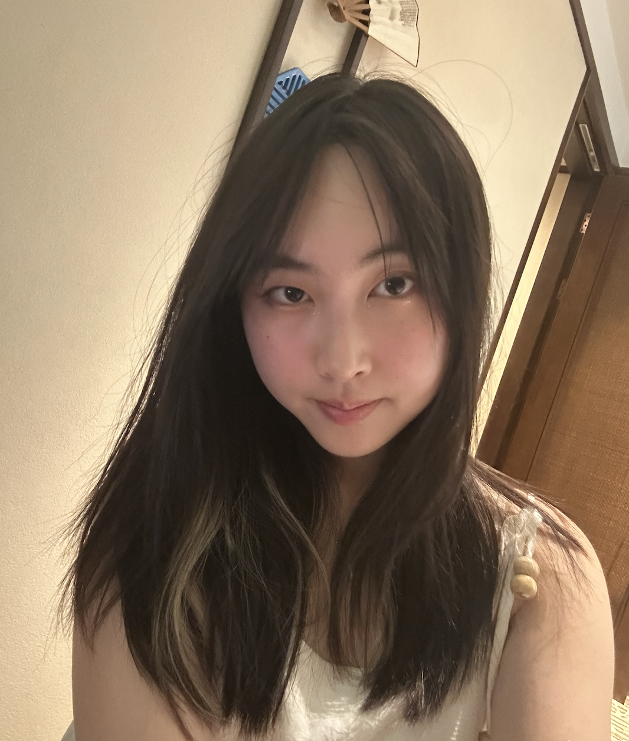
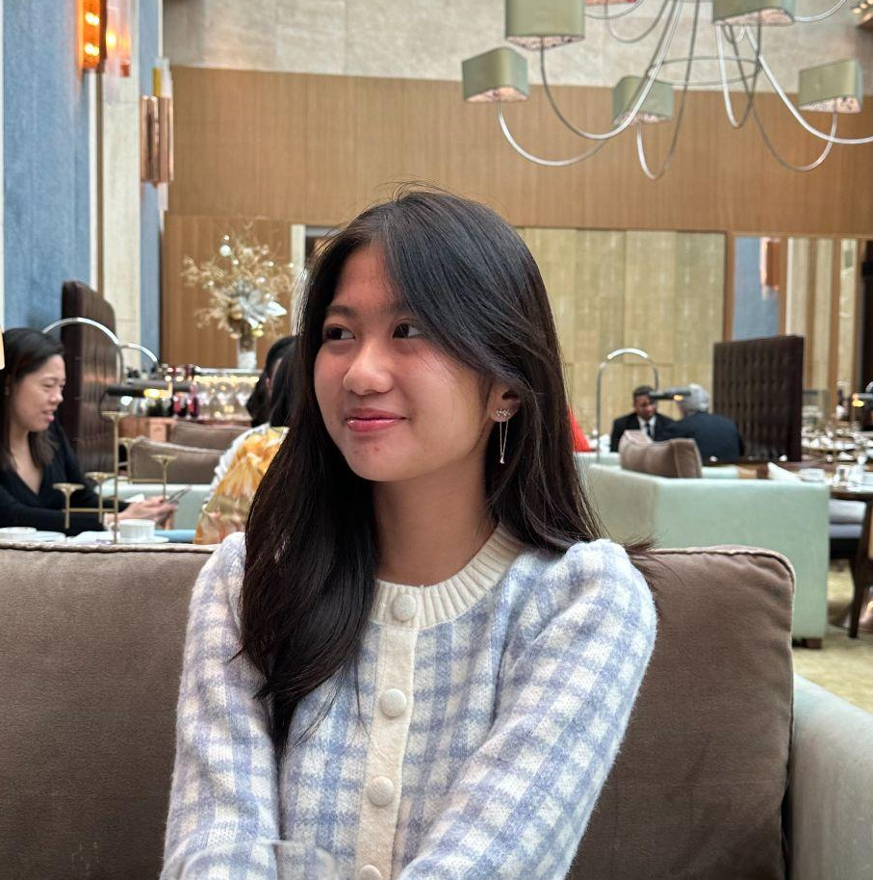
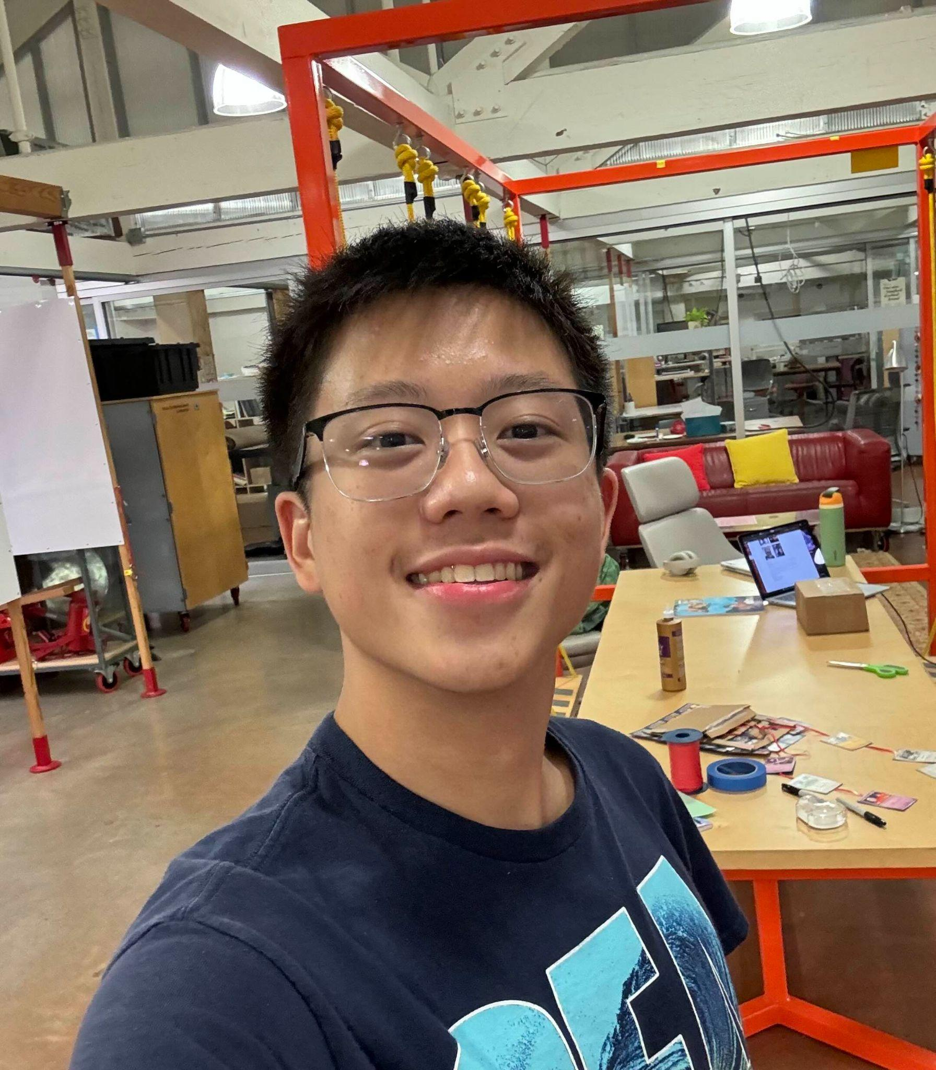
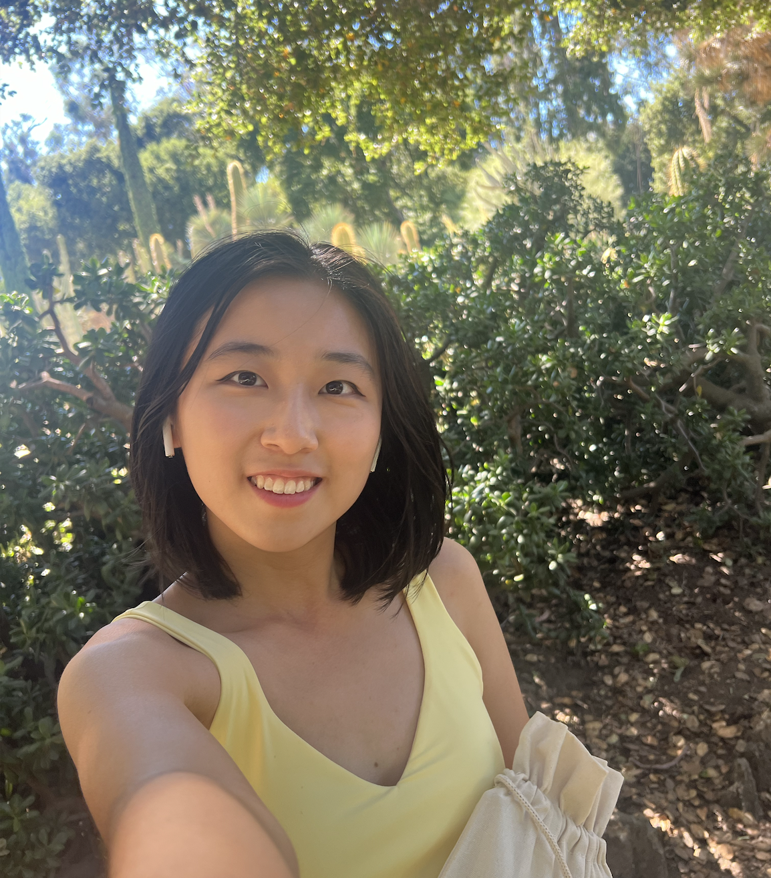
We are team planet!
Kristine Ma
Carolyn Lee
Lucas Wang
Evelyn Song
Junior
Symbolic Systems (HCI)
Junior
Computer Science (HCI)
Sophomore
Design +
CS (HCI)
Junior
Human Biology + CS (HCI)

Slide 3
Problem Overview
Primary user
Problem We’re Tackling
College students with existing friends, who find it difficult to reach out
Connecting to friends is seen as time consuming and inconvenient to the other person

Slide 4

Solution
Planet!
A tool that allows users:
update friends on their own mood and status,
easily find out availabilities on friends’ schedules,
quickly propose hangout times.

Slide 5
Friends living in different worlds?
Just plan(et).

Slide 6
Value proposition
Planet lets you visually connect with your friends' emotions and statuses in real-time, so you never feel alienated and always know who's able to hang out or needs companionship.

Slide 7
Contents
01
Heuristic Evaluation
02
Hifi revisions
03
Hifi implementation
04
Demo of a task

Slide 8
01
Heuristic Evaluation Results

Slide 9
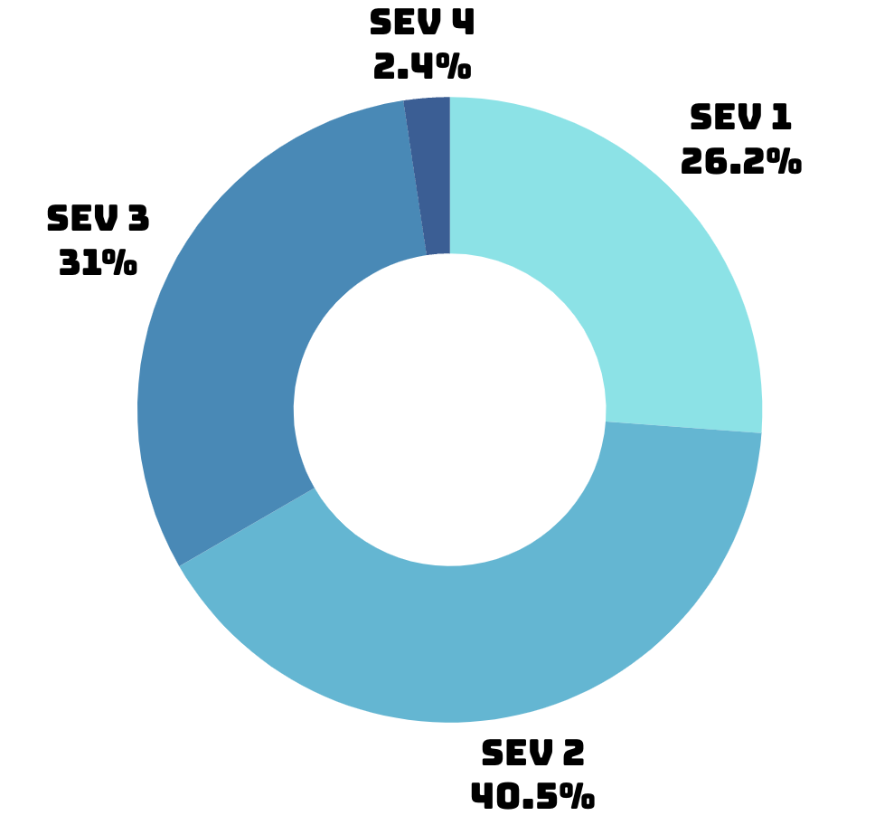
42 total violations

Slide 10
Summary of Violations
 | SEV 3 | SEV 4
H1 | 3 | 0
H2 | 1 | 0
H3 | 0 | 0
H4 | 0 | 0
H5 | 1 | 0
H6 | 2 | 0
 | SEV 3 | SEV 4
H7 | 1 | 0
H8 | 1 | 0
H9 | 1 | 0
H10 | 2 | 0
H11 | 0 | 0
H12 | 1 | 1

Slide 11
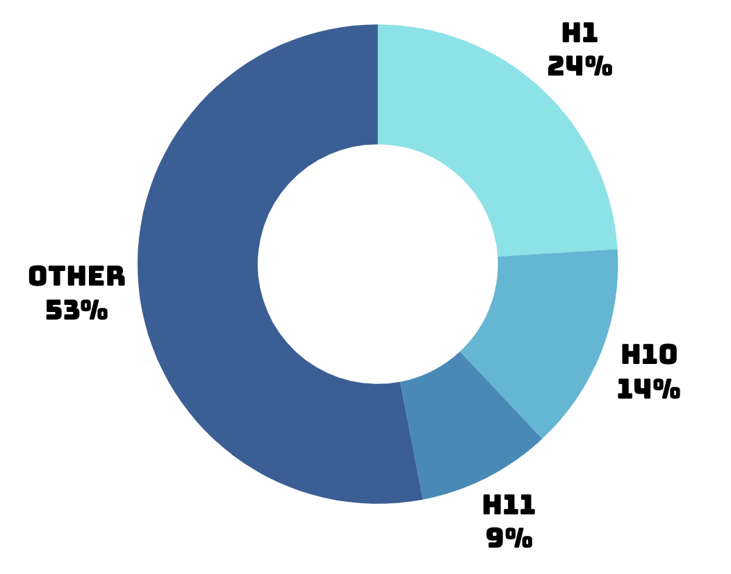
Most common violations
24%
9%
14%
H1: Visibility of System Status
H11: Accessible Design
H10: Help & Documentation
Notes:
total violations, severity breakdown, most common violations, total number of revisions

Slide 12
total number of revisions
Severity 3-4:
14 HE violations → 13 revisions
Severity 1-2:
28 HE violations → 5 revisions

Slide 13
02
Hifi revisions

Slide 14
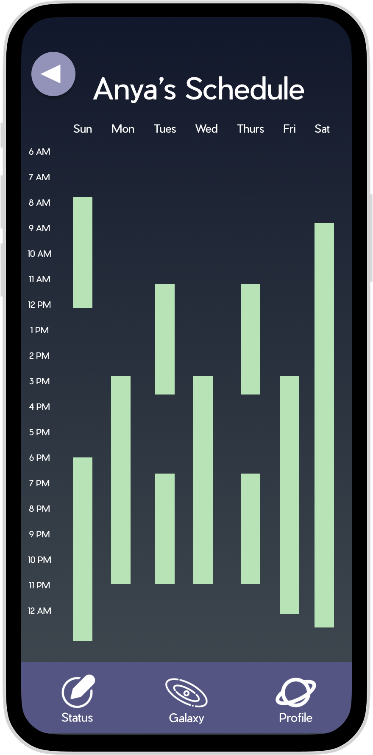
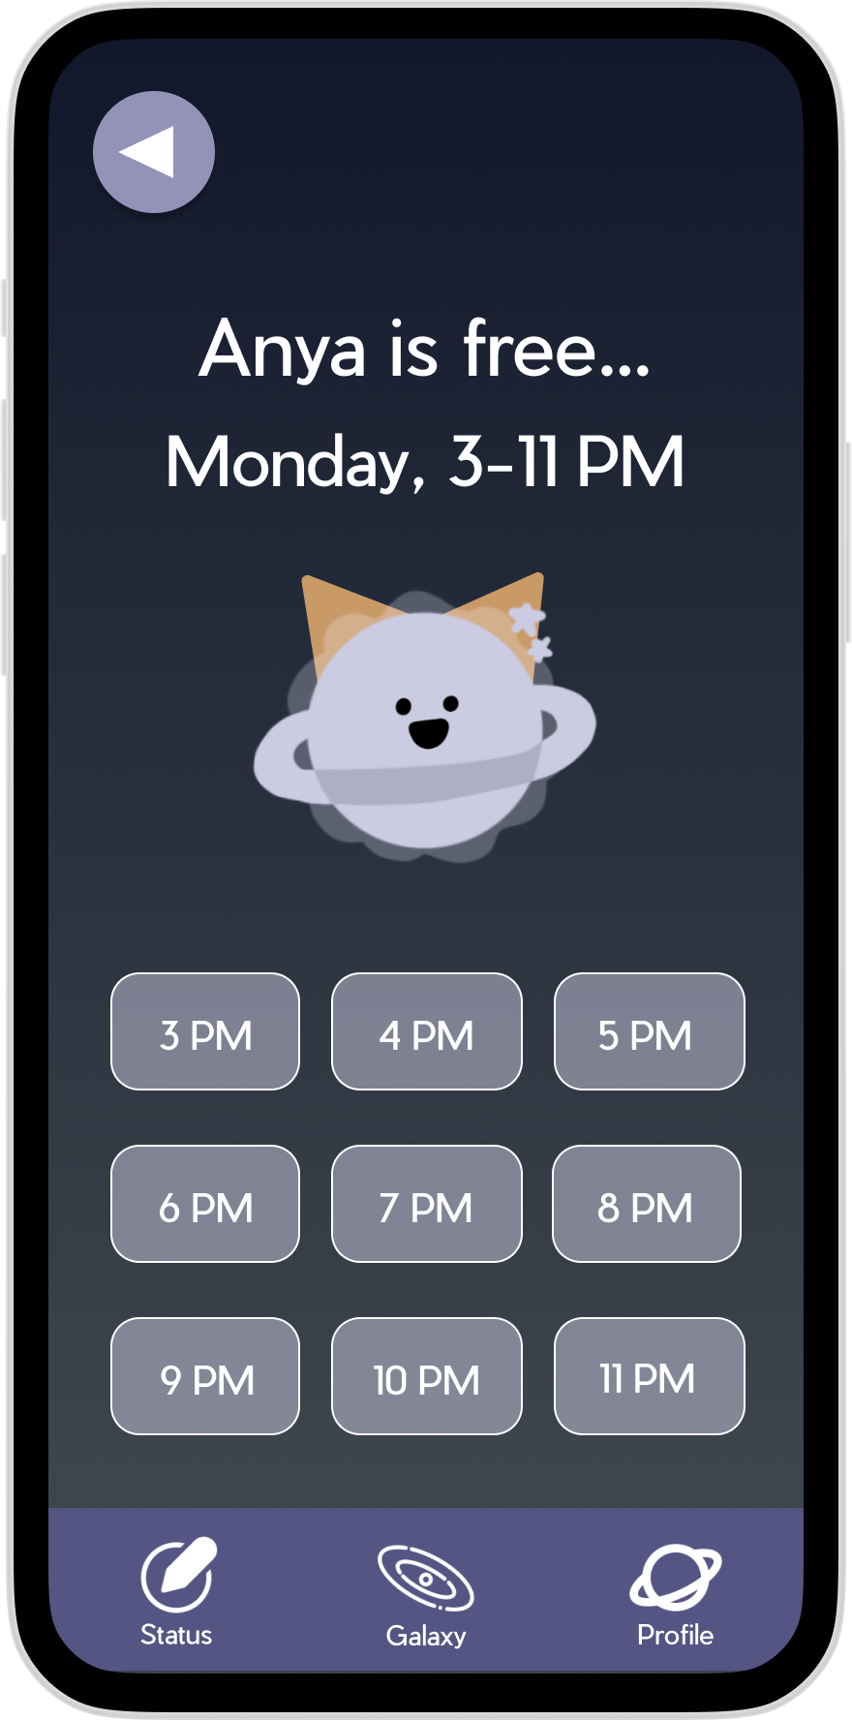
Issue 1
BEFORE
“I was not sure what to do once I was on the schedule page, didn't know that the time blocks were buttons” – All 3 reviewers
H7: Flexibility & Efficiency of Use;
H10: Help & Documentation

Slide 15
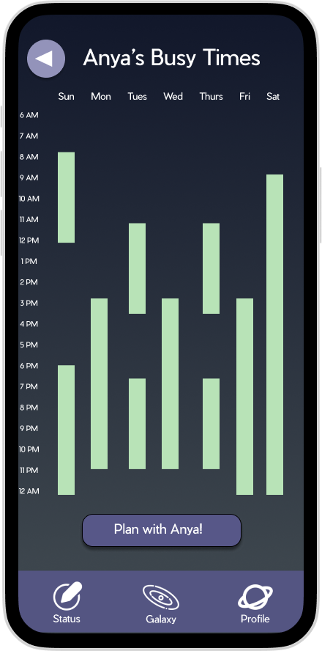
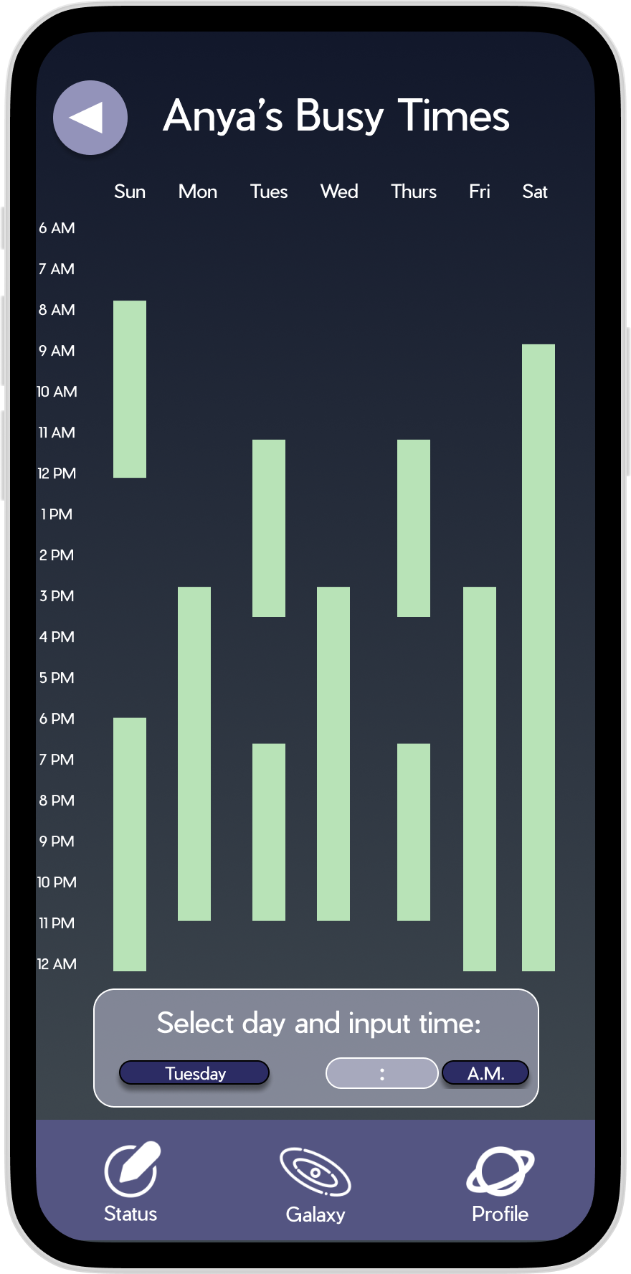
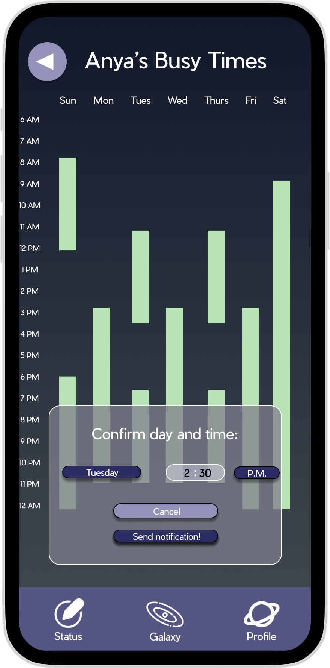
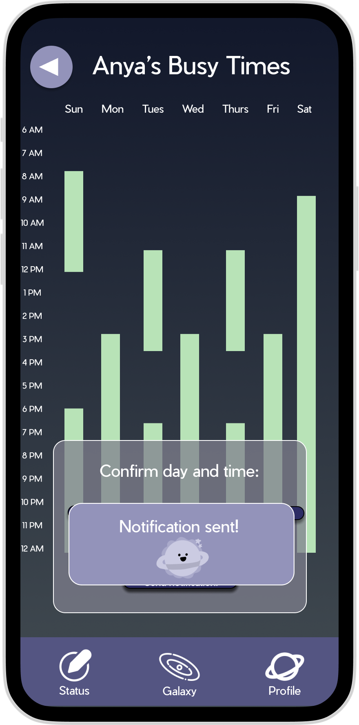
Fixes:
Added “Plan” button underneath schedule
Renamed title of schedule (HE#32, #33)
Send in-app notification (not iMessage)
AFTER
Notes:
Renamed title of schedule, added “Plan” button underneath schedule (H10: Help and Documentation, HE #33)

Slide 16
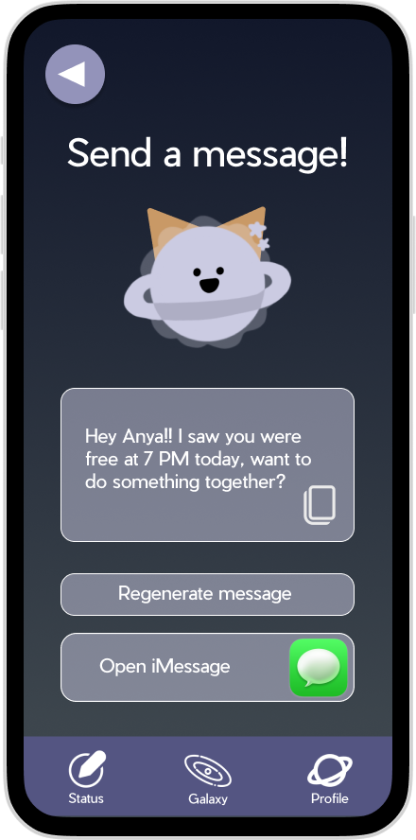
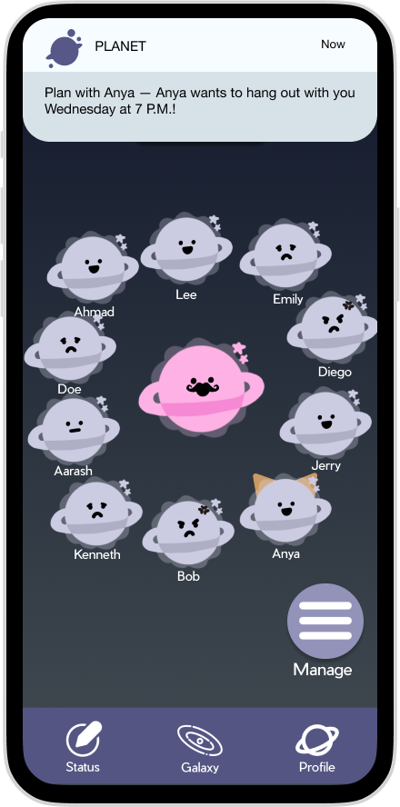

fixes:
BEFORE
AFTER
Messaging system → a ping-based system (HE #27)
Aligns better with our aim to allow users a quick-and-easy way to reach out! (HE#28)
Notes:
This change addresses some heuristics relating to difficulty of use -> unclear who you’re messaging (H6: Recognition not Recall, HE #27), size difference between copy button and message button (H8: Aesthetic & Minimalist Design, HE #28)

Slide 17
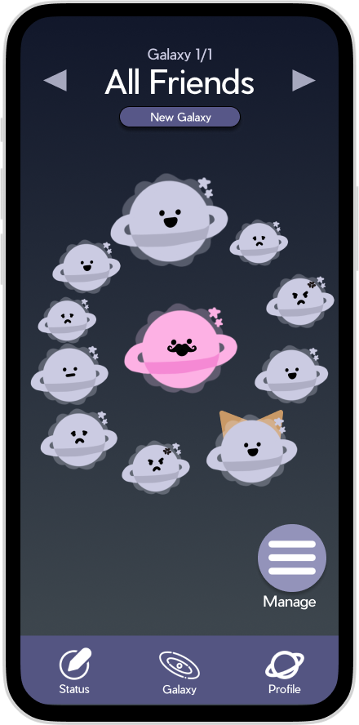
Issue 2
BEFORE
“What happens if I can’t remember the look of a friends planet? What happens if they change their looks?” – All 3 reviewers
H6: Recognition not Recall

Slide 18
Issue 2
BEFORE
“Some of the friend planets are smaller or bigger than others, does this mean they're more important, more active?” – All 3 reviewers
H12: Value Alignment & Inclusion

Slide 19
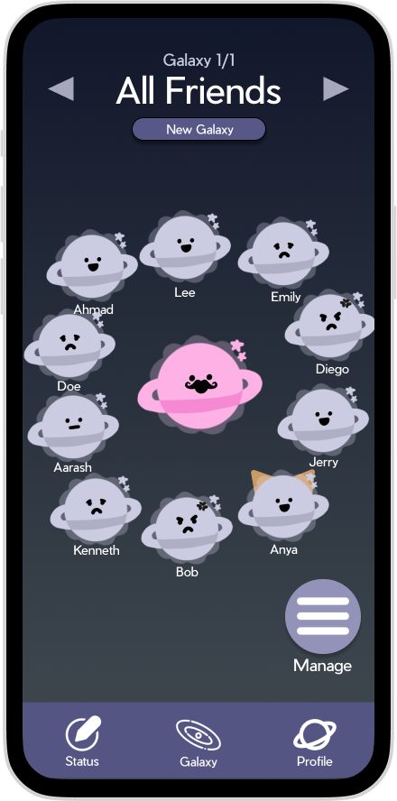
Fixes:
BEFORE
AFTER
Standardized planet sizes (HE #30)
Added names to planets (HE #29)
Notes:
Standardized planet sizes (H12: Value Alignment & Inclusion, HE #30),
Added names to planets (H6: Recognition not Recall, HE #29)

Slide 20
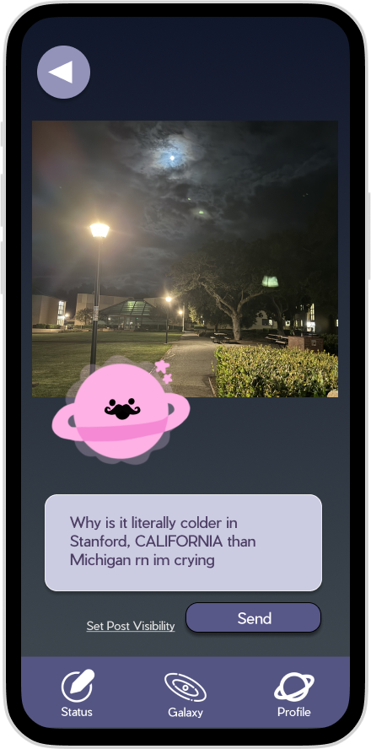
Issue 3
BEFORE
Setting post visibility is once-and-for-all;
Can’t access this info after posting.
– All 3 reviewers
H1: Visibility of System Status

Slide 21
Issue 3
BEFORE
“Shortcut from visibility changing screen and regular status creation screen can post status without warning” – All 3 reviewers
H5: Error Prevention

Slide 22
Issue 3
BEFORE
“I clicked send for my emotional status without noticing that I should set my visibility.” – All 3 reviewers
H9: Help Users with Errors

Slide 23

Fixes:
BEFORE
AFTER
Removed post visibility feature (HE #42)*
*Also addresses shortcut from visibility screen moving to wrong screen (HE #41), clicked send before knowing to set visibility (HE #38), and not knowing visibility of a post after sending it (HE #34)
Notes:
Removed post visibility feature (H12: Value Alignment & Inclusion, HE #42)
Also addresses shortcut from visibility screen moving to wrong screen without warning (H5: Error Prevention, HE #41), clicked send before knowing to set visibility for complex task (H9: Help Users with Errors, HE #38), and not knowing visibility of a post after sending it (H1: Visibility of System Status, HE #34)

Slide 24


Issue 4
BEFORE
"’Set Status’ / ‘Your Status’ page is inconsistent with ‘My Planet’ and ‘My Orbit’." – 2 reviewers
H2: Match b/w System & World

Slide 25
Issue 4
BEFORE
“Navigation bar could be more concise.” – 2 reviewers
H8: Aesthetic & Minimalist Design

Slide 26
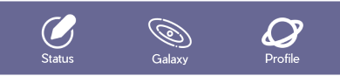
Fixes:
BEFORE
Changed inconsistencies between “SET status” and “MY planet” and “MY orbit” by renaming all text (HE #36)*
Which also makes navigation bar more concise (HE #37)
*Also addresses inconsistency with “Orbit” and “Galaxy” text throughout application (HE #40)
AFTER
Notes:
Changed inconsistencies between “SET status” and “MY planet” and “MY orbit” by renaming all text (H2: Match b/w System & World, HE #36) which also makes navigation bar more concise (H8: Aesthetic & Minimalist Design, HE #37)
Renamed “orbit” text to “Galaxy” both on navbar and throughout application (H6: Recognition not Recall, HE #40)

Slide 27
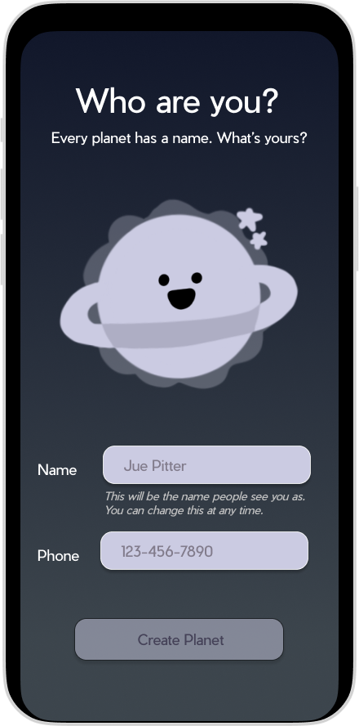
Issue 5
BEFORE
“No back arrow to return to previous page when creating a galaxy.” – 2 reviewers
H5: Error Prevention

Slide 28
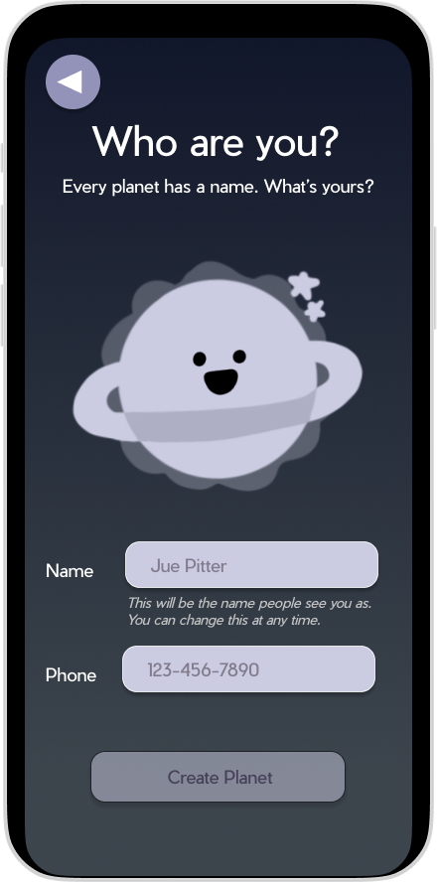
fixes:
AFTER
Added back buttons to onboarding screen (HE #18)
Notes:
Added back buttons to onboarding screen (HE #18)

Slide 29
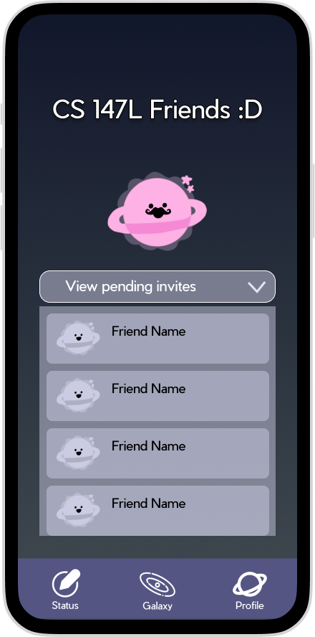
Issue 6
BEFORE
“If I post a status to certain galaxies, what happens if I want to post a new status to a different galaxy?” – 1 reviewer
H12: Value Alignment & Inclusion

Slide 30
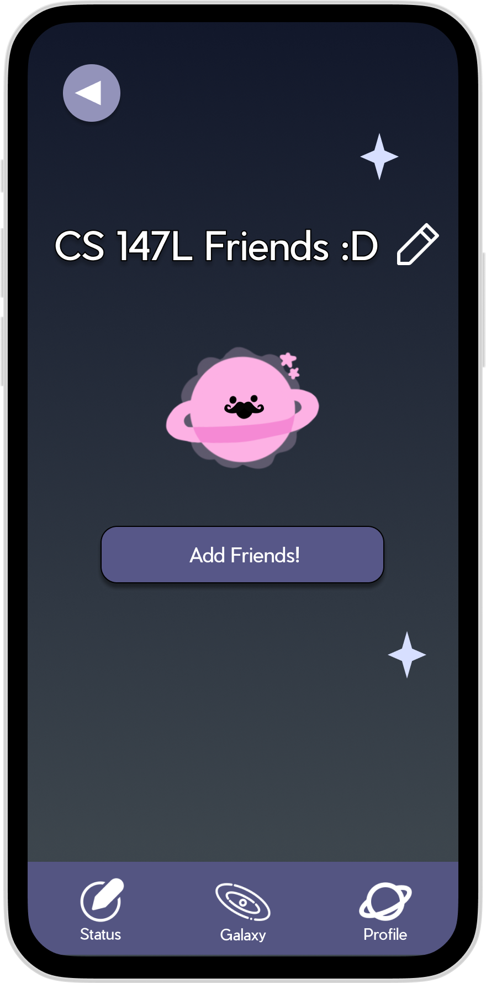
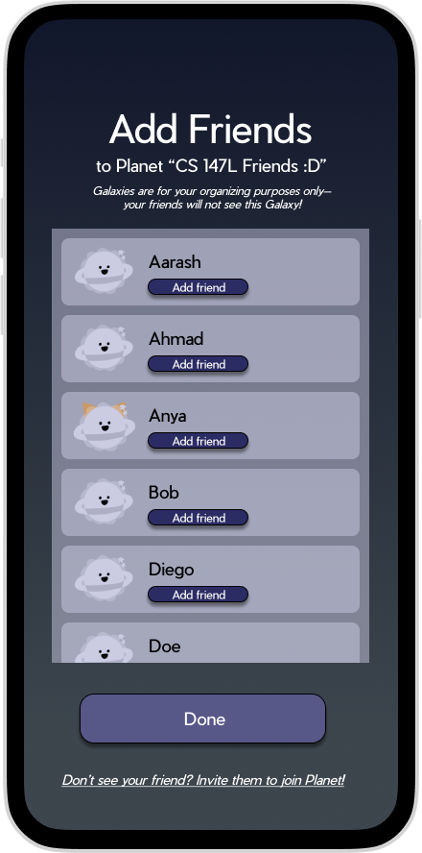
fixes:
AFTER
Galaxy are only for organization, replacing the previous “friend group” concept
Which dresses some errors with editing who is in a galaxy (HE #39)
Notes:
Removed pending invite system, revamped organization system to be cosmetic only (friends do not need to be “invited” into groups because they are only an organization tool, like how you can organize Discord servers into groups) that you can add/remove at any time -> this addresses some errors with editing who is in a galaxy (HE #39) and having no back button in the invite page (HE #18)

Slide 31
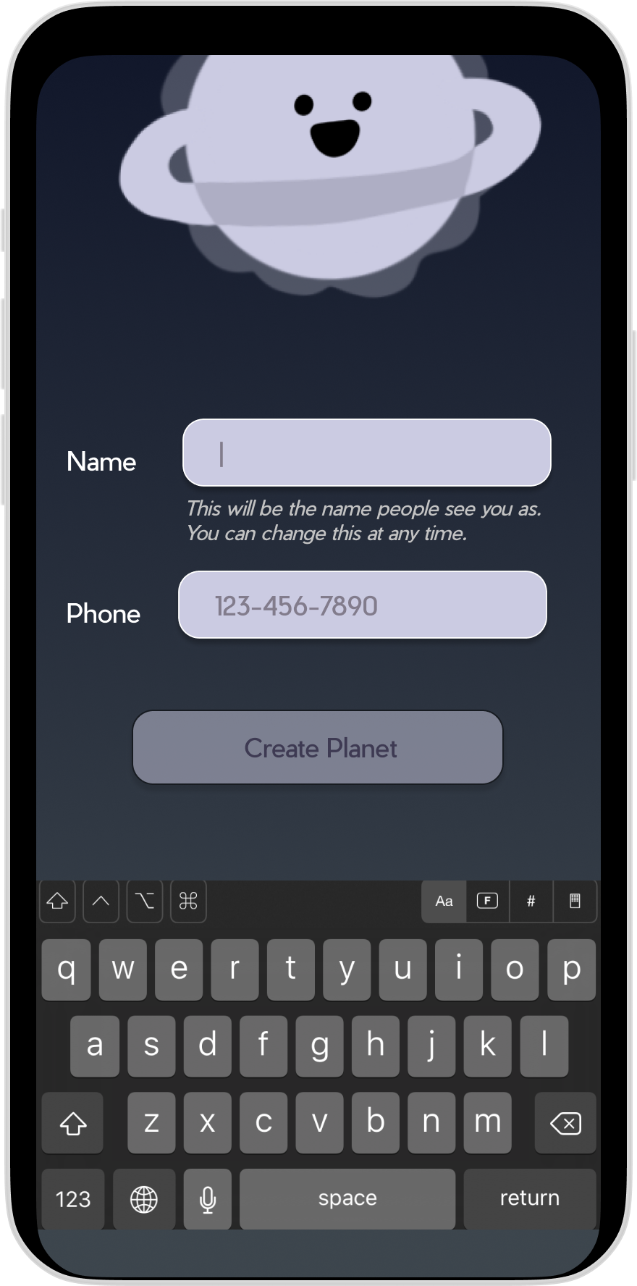
issue 7
BEFORE
“When creating an account and a name, it says that you can change this at any time... where?” – 1 reviewer
H10: Help & Documentation

Slide 32
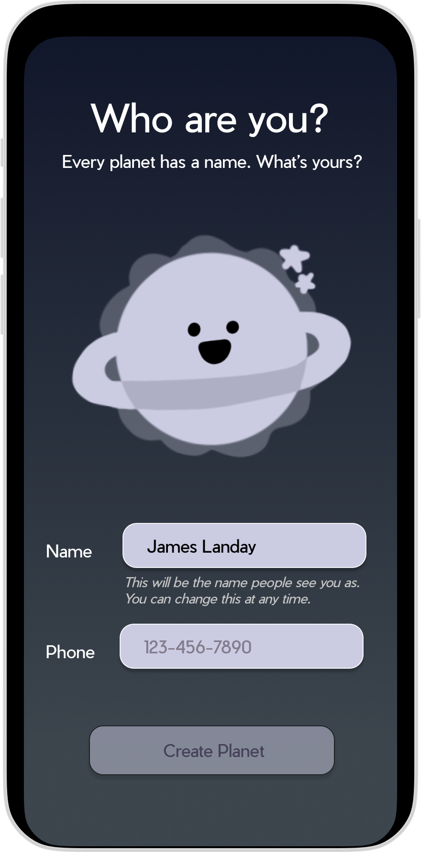
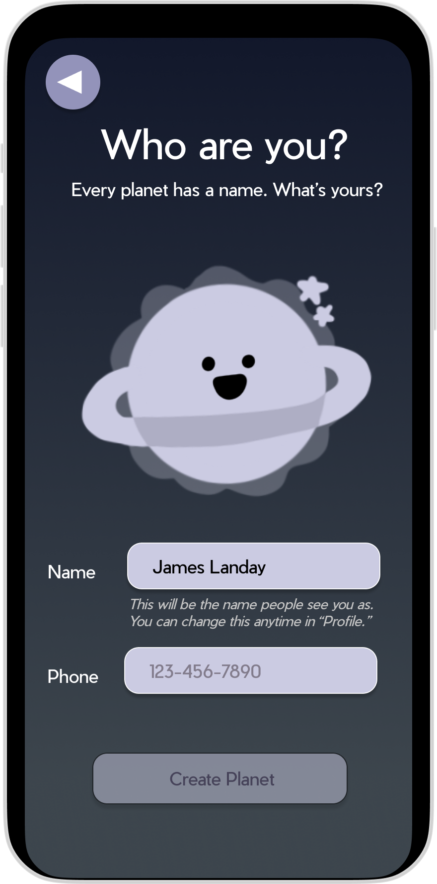
Fixes:
BEFORE
AFTER
Added clearer instructions in the subtext below entry box (# 31)

Slide 33
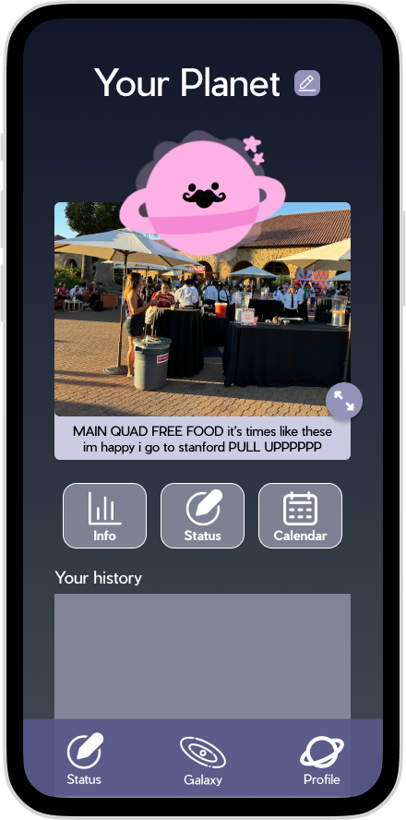
Unaddressed HE
“You can ‘Set Status’ in two places on both "My Planet" and navigation bar ...” – All 3 reviewers
H4: Consistency & Standards
Reason for not addressing: There are many ways to do the same thing! (in successful apps!)

Slide 34
Progress towards usability goals
Intuitiveness
Added clearer text instructions below entry boxes (e.g., for creating accounts and names).
Standardized planet sizes and added names to planets for easier recognition.
Renamed “orbit” to “galaxy” and ensured consistent text labels for better navigation.
Friend organized through “galaxies” - easier than before!

Slide 35
Progress towards usability goals
effectiveness
inclusivity
Added back buttons to onboarding and other key pages for smoother navigation.
Fixed shortcut issues to prevent accidental actions (e.g., posting statuses without setting visibility).
Galaxies revamped to emphasize friendship & connection and prevent feelings of cliquiness and exclusion

Slide 36
03
Hifi implementation

Slide 37


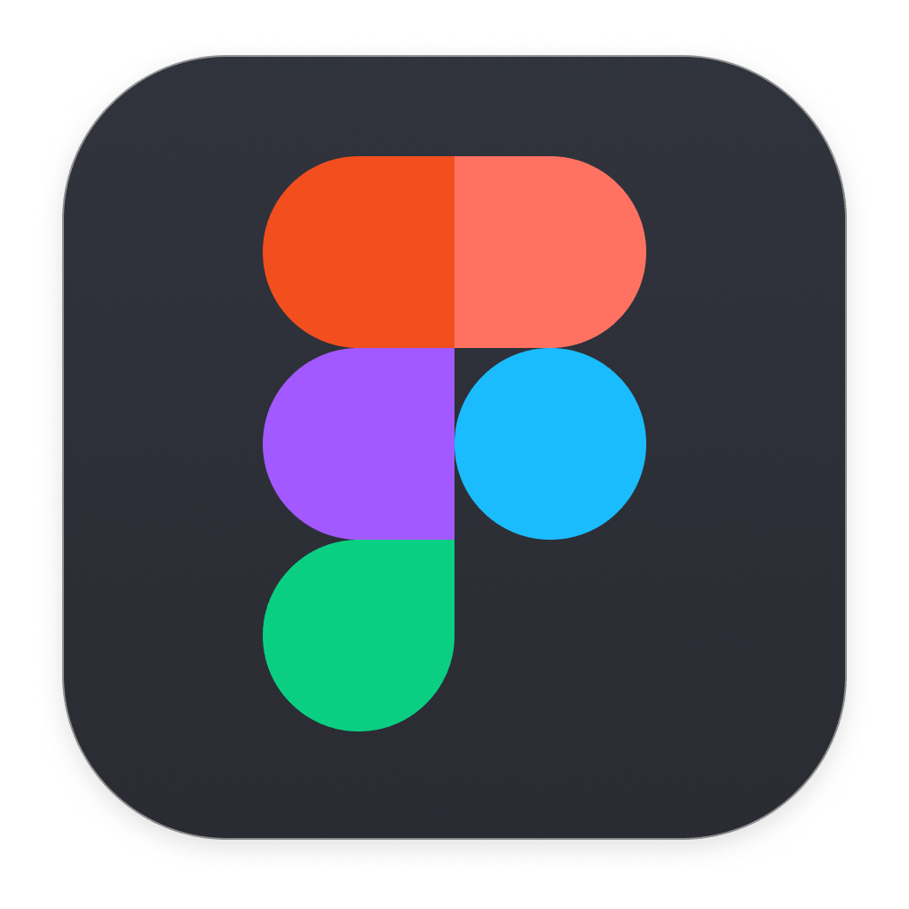


Tools Used
React Native
Expo
Supabase
figma
VS Code
Application
Framework
Software
Development Kit
Database Management
Design
Components
IDE for
Coding
Notes:
React Native, Expo, Supabase, Visual Studio, Figma

Slide 38
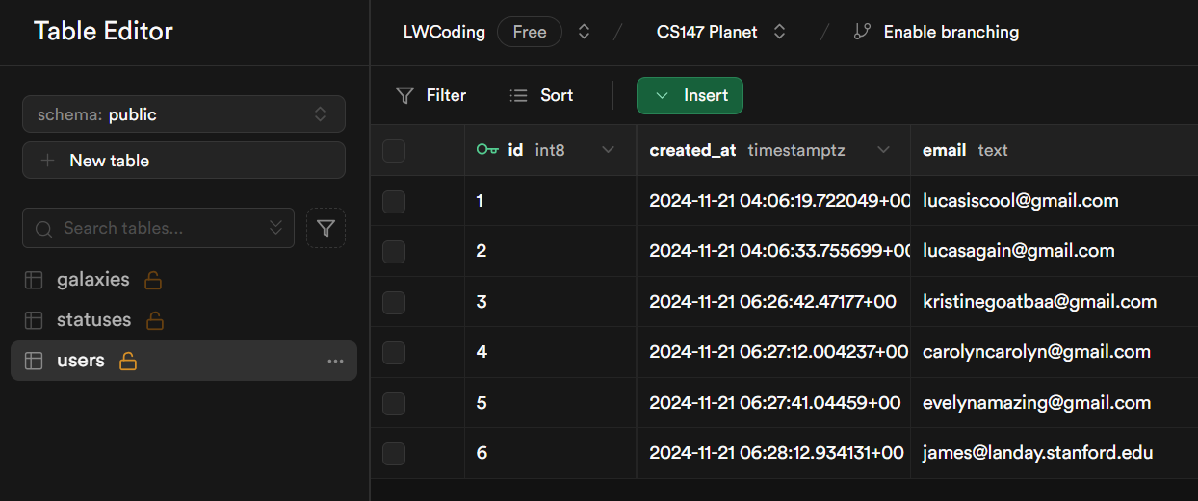
Implemented features
Homepage screen
Other user account screen
User & statuses database
Loading info from database
Notes:
Attached image is our database (Supabase backend)

Slide 39
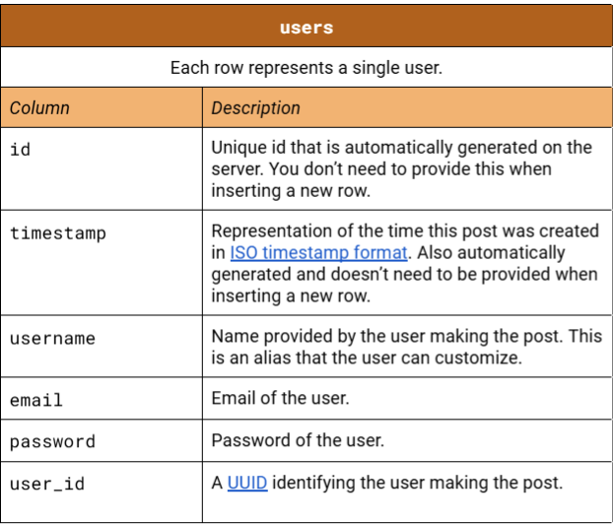
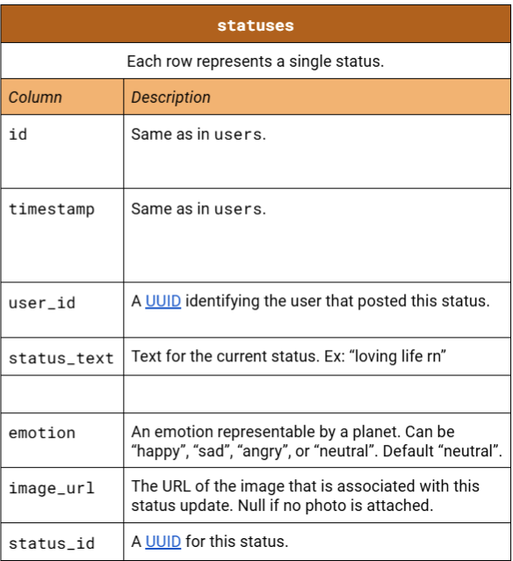
Implemented features
Notes:
Attached image is our database (Supabase backend)

Slide 40
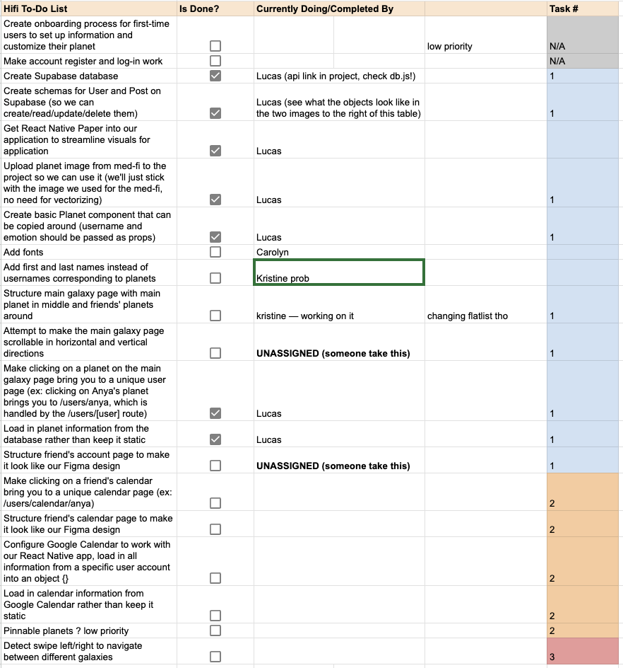
unImplemented features & plan
Onboarding process
Adding/removing friends
Setting your own account info
Posting a photo status
Organizing friends into galaxies
Scheduling feature (calendar sync)
Plan: Implement them all during Thanksgiving! So we could take an easy week 10 :)

Slide 41


Wizard of oz
Hard-coded
Friends in the Galaxy have been “magically” added
The Status never expires (we plan to have it expire after 24 hours).
All user profiles (names, statuses, emotions)
User planet outlooks
User status text & emotions
Photo statuses

Slide 42
04
Demo:
VIEW/SET statusES

Slide 43


Slide 44

Thank you!!

